Slide 1

Selection components in Delphi Combo boxes List boxes Radio groups
Make a choice

Slide 2
The List box, combo box and the radio group components allow options to be selected.
Advantages:
Enhances the visual presentation of options
Automatic validation, only a valid selection can be made, prevents the user from entering an invalid value.
Options can be String, numbers, dates, and other types
(must be extracted as a string and then be converted to the relevant data type)
EASY to extract and manipulate data using code or the Properties in the object inspector.

Slide 3
Common properties to change
The Name property of the component List box prefix: lst for example lstFruit Combo box prefix: cmb for example cmbFruit Radio group: rgp for example rgpFruit
The Caption property is used to set the heading for the Radio group
The Text property is used to set the heading for the Combo box
The Items property is used to add items to all three components
The ItemIndex property is used to point to the position/ index of an item in all three components.

Slide 4
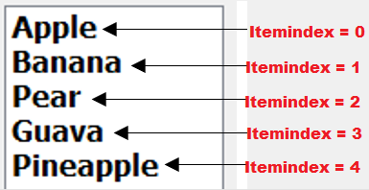
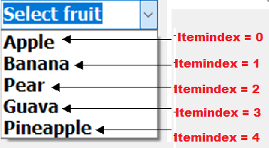
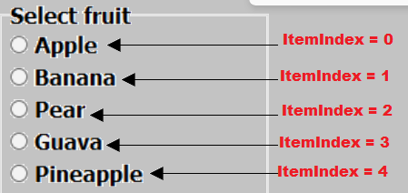
THE DIFFERENT SELECTION COMPONENTS
LIST BOX
COMBO BOX
RADIO GROUP
Collapsable
Name: lstFruit
Name: cmbFruit
Text: Select fruit
Name: rgpFruit
Caption: Select fruit

Slide 5
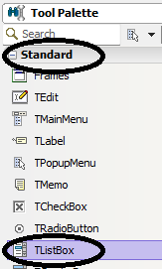
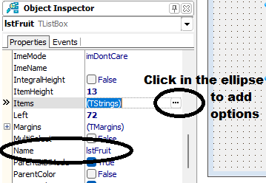
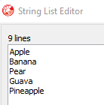
LIST BOX
Step 2
Step 3
Step 1
Select a TListBox from the Tool Palette
Change the name in the Object Inspector to lstFruit
Select the Items property Add options to the String List Editor

Slide 6
Other properties
Clear
Count
Add
To clear the list box
lstFruit.Items.Clear
To count the number of options/ items in the list box
iNum := lstFruit.Items.Count
Add items to the end of a list box
lstFruit.Items.Add(‘Kiwi’)
Delete
Insert
IndexOf
Removes an item at a selected index
lstFruit.Items.Delete(2) will delete the third item
Insert an item to a specified index in the list box
lstFruit.Items.Insert(1,’Peach’) will insert Peach in the second position
The index position of an item
iPosition := lstFruit.Items.IndexOf(‘Guava’)
Will find the position/ index of Guava

Slide 7
Selection components and text files
LoadFromFile
SaveToFile
Populates a list box with options using the data from a text file.
For example:
lstFruit.Items.LoadFromFile(‘Fruit.txt’);
Will read the data from the text file Fruit.txt and save the data as options in the list box
lstFruit. NB: The text file must be saved in the same folder as the Delphi project.
Saves the options from the list box into a new text file.
For example:
lstMenu.SaveToFile(Menu.txt);
Will save the content/options in the list box lstMenu into a new file Menu.txt. The text file will be saved in the same folder as the Delphi project.

Slide 8
No selection made
Use the ItemIndex function
ISelectedIndex:= lstFruit.ItemIndex;
If iSelectedIndex = -1 then Showmessage(‘No selection’);

Slide 9

THANK YOU

